Slide 1
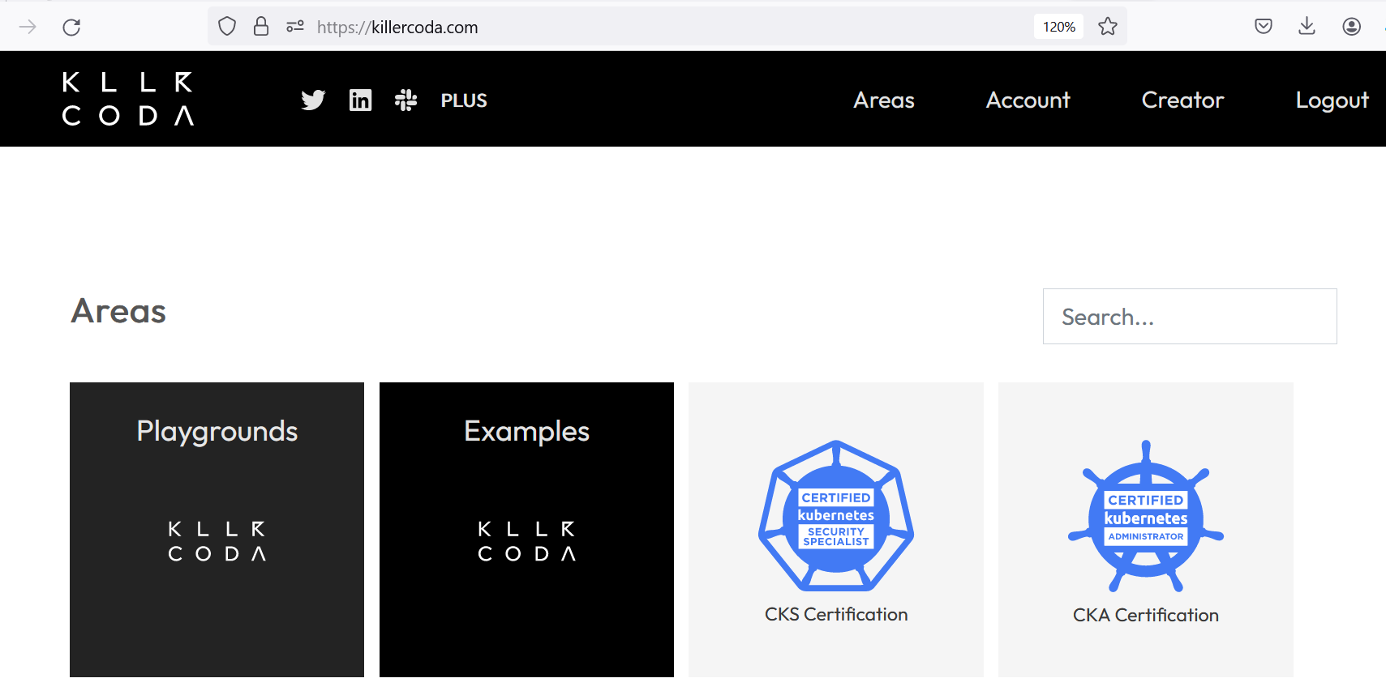
Lab setup > https://killerkode.com

Slide 2
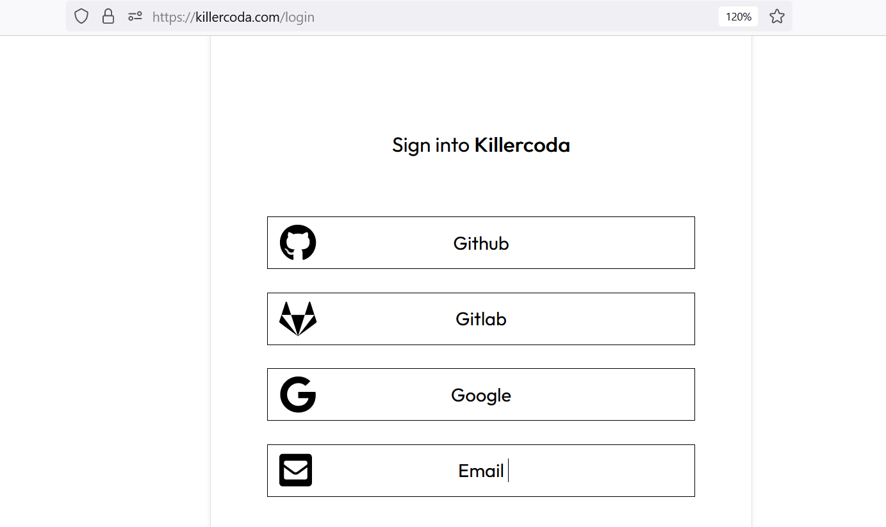
Login option

Slide 3
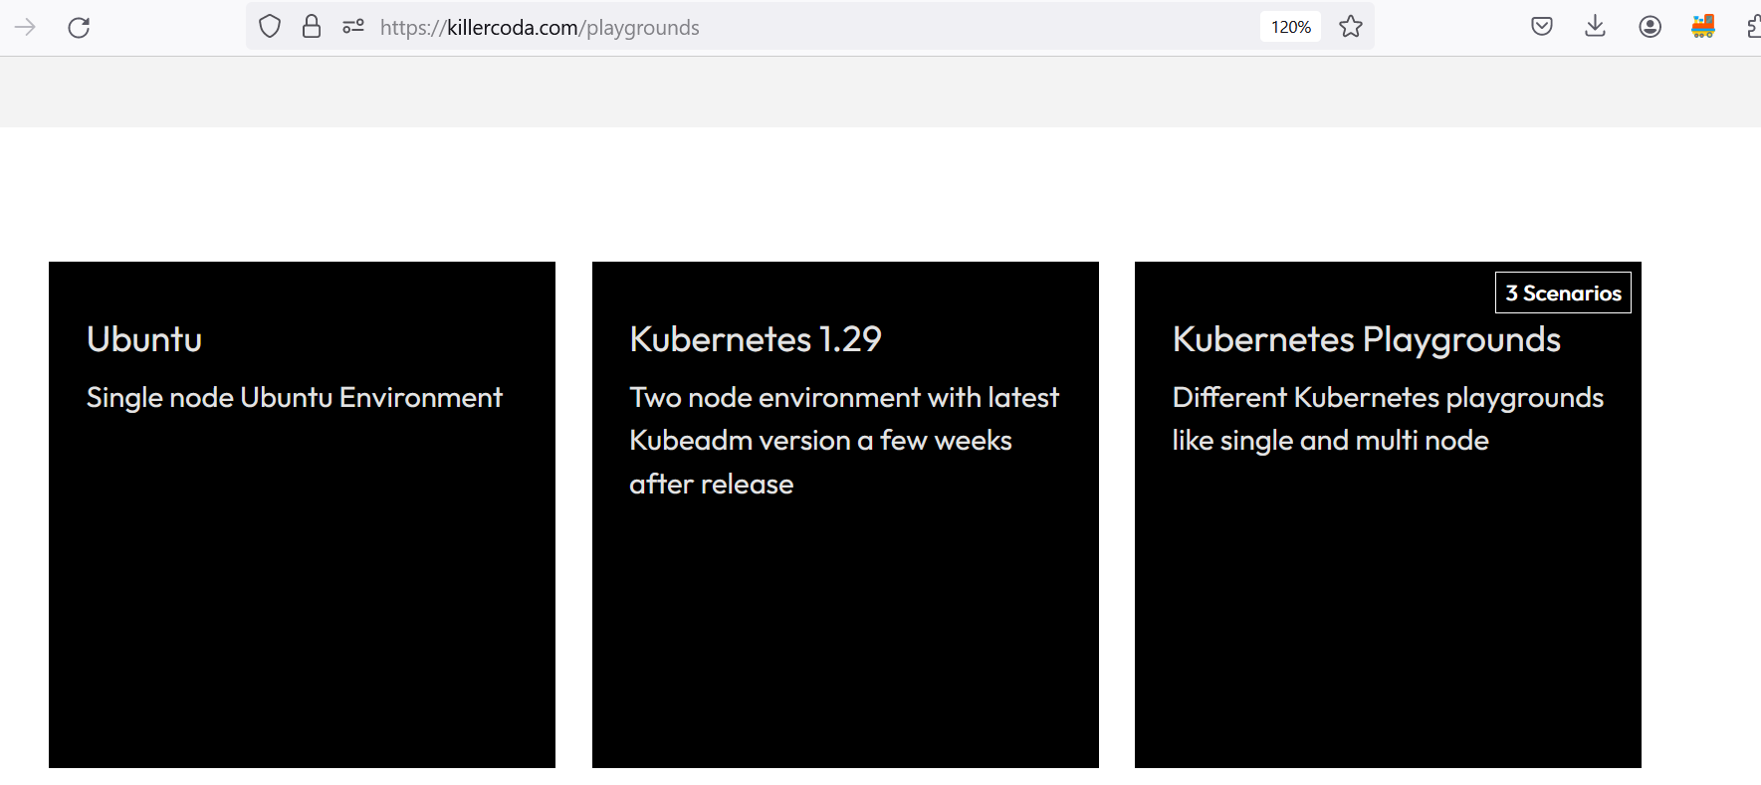
Select ubuntu playground

Slide 4
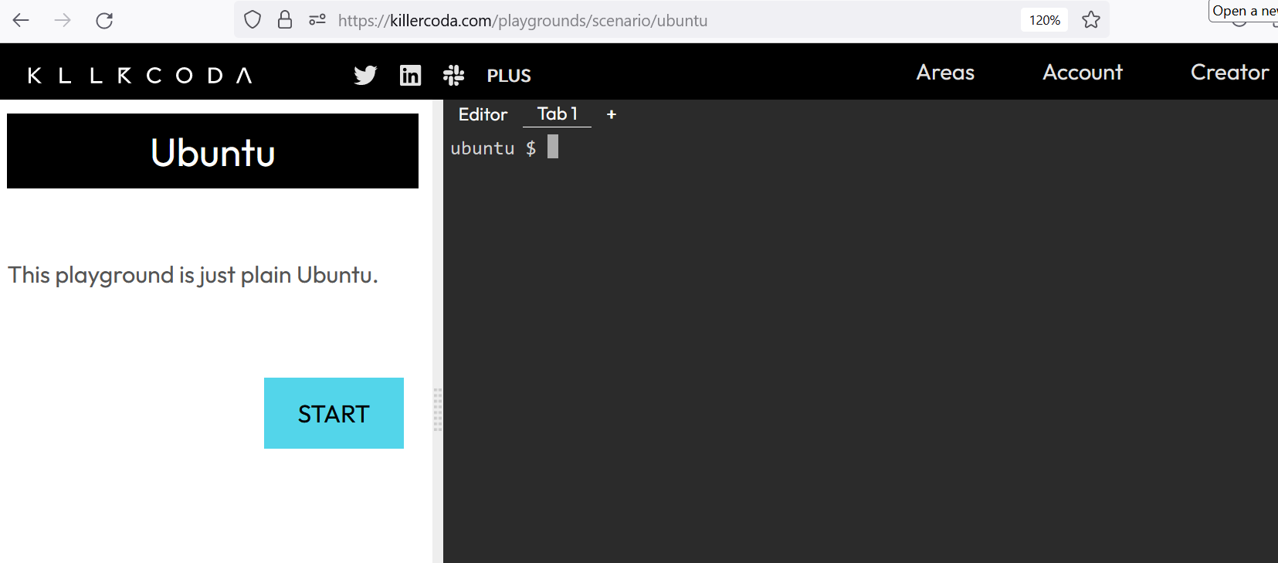
Ubuntu terminal

Slide 5
Terraform installation
https://developer.hashicorp.com/terraform/install

Slide 6
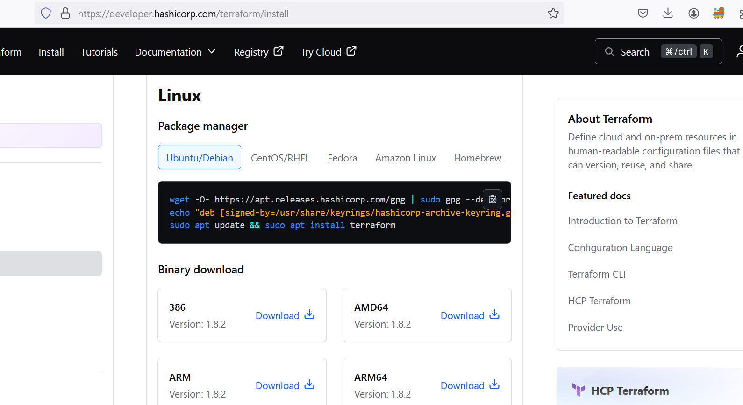

Slide 7
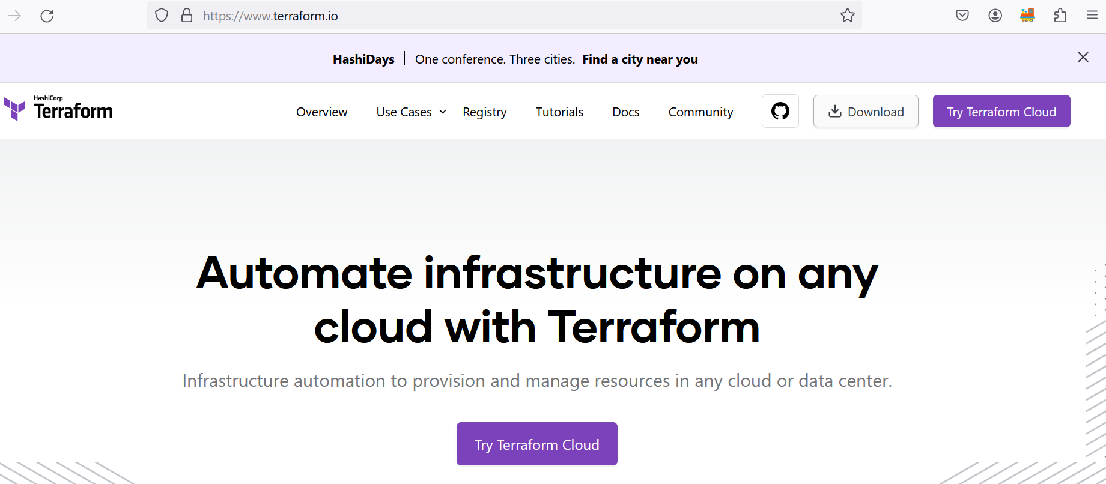
What is Terraform
Automation tool for creating infrastructure on any cloud.

Slide 8
How to do automation?
Follow Terraform documentation. Terraform provides very good documentation that you need to follow blindly.
Terraform URL: https://www.terraform.io/

Slide 9
Terraform core concept
Resource: This is the infrastructure which you want to create
Provider: This refers to where you want to create infrastructure
Argument: The inputs which we express in terraform are called as arguments
Output: The output given by terraform is referred as attribute

Slide 10
How to write terraform code?
Prework: Identify the cloud provider, and what you want to create.

Slide 11
Basic programming and their extension
C > PROGRAMNAME.C
JAVA> PROGRAMNAME.JAVA
C++> PROGRAMNAME.JAVA
Terraform> PROGRAMNAME.tf [main.tf by default]

Slide 12
Application requirement
Lets assume my requirement is to create azure webapp on Azure cloud.

Slide 13
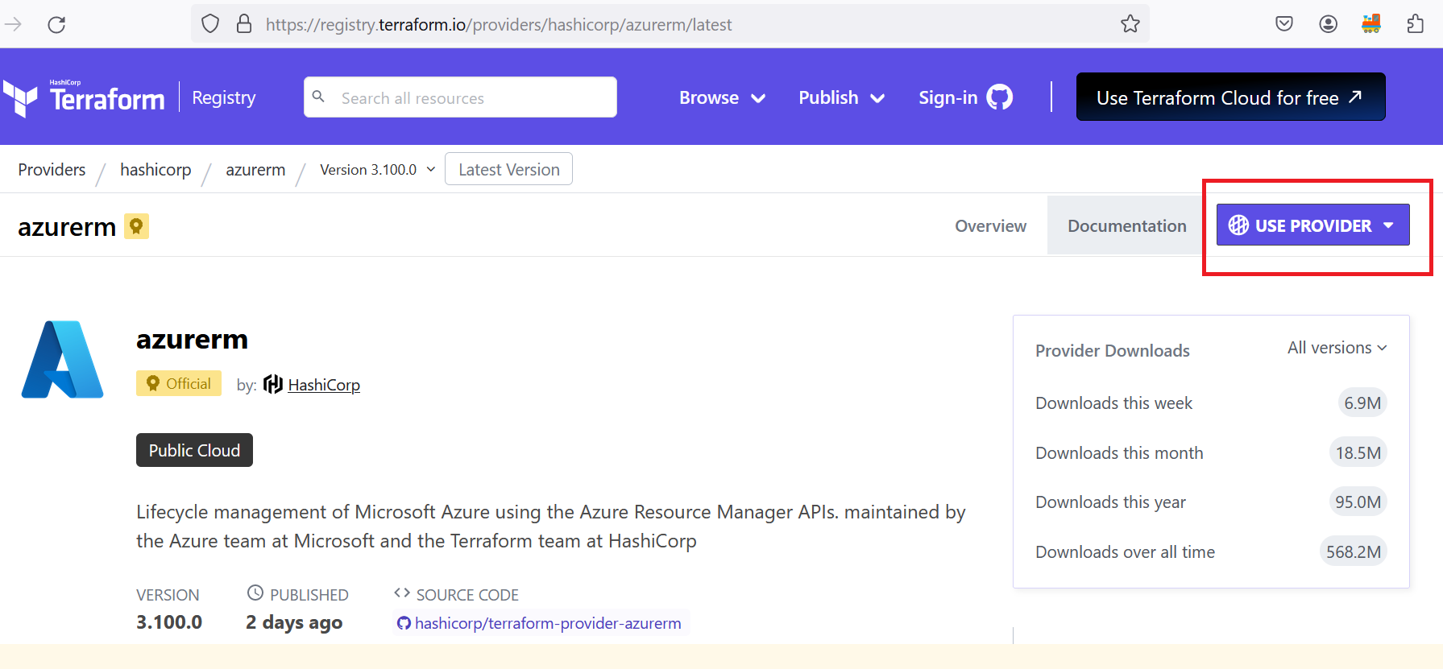
Providers documentation

Slide 14
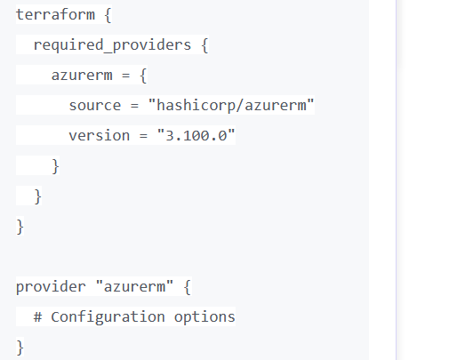
Main.tf

Slide 15
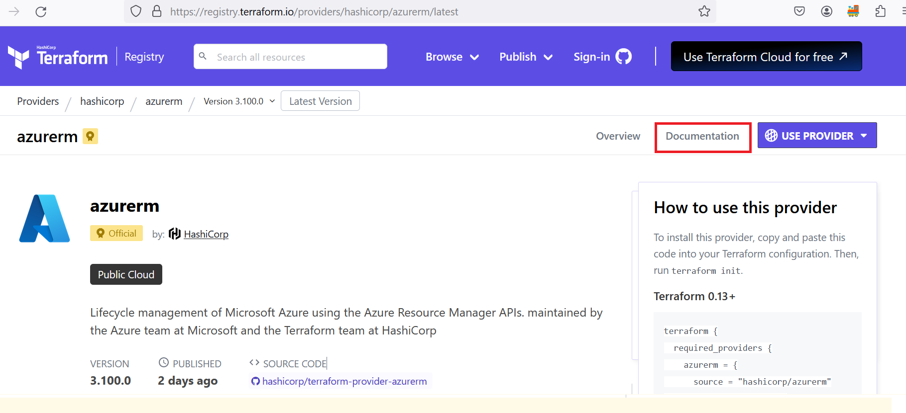
Azure documentation

Slide 16
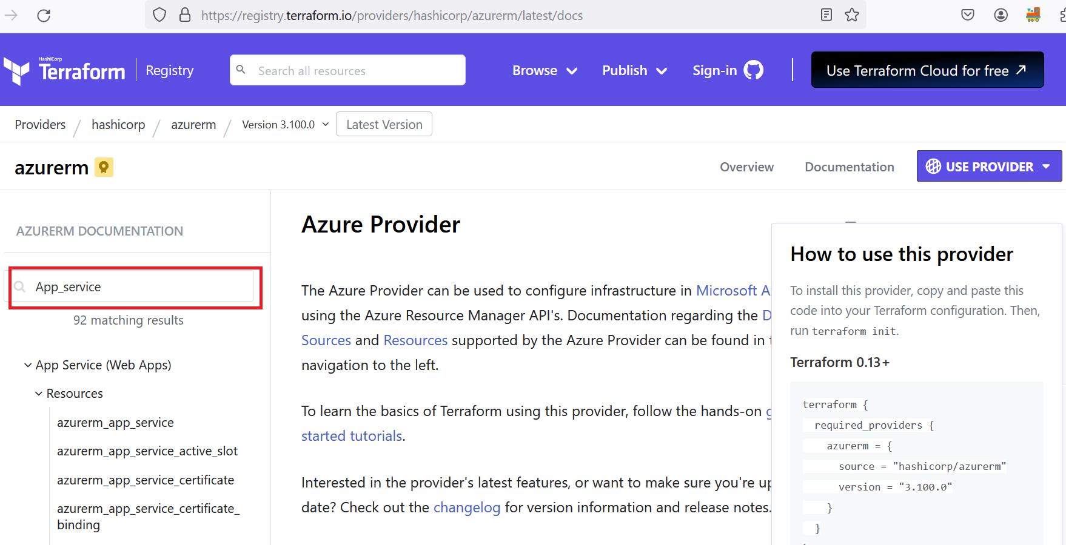

Slide 17
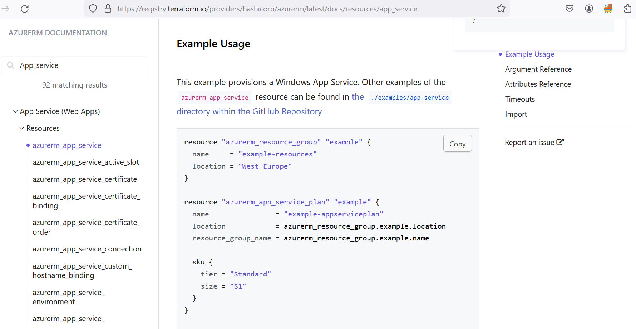

Slide 18
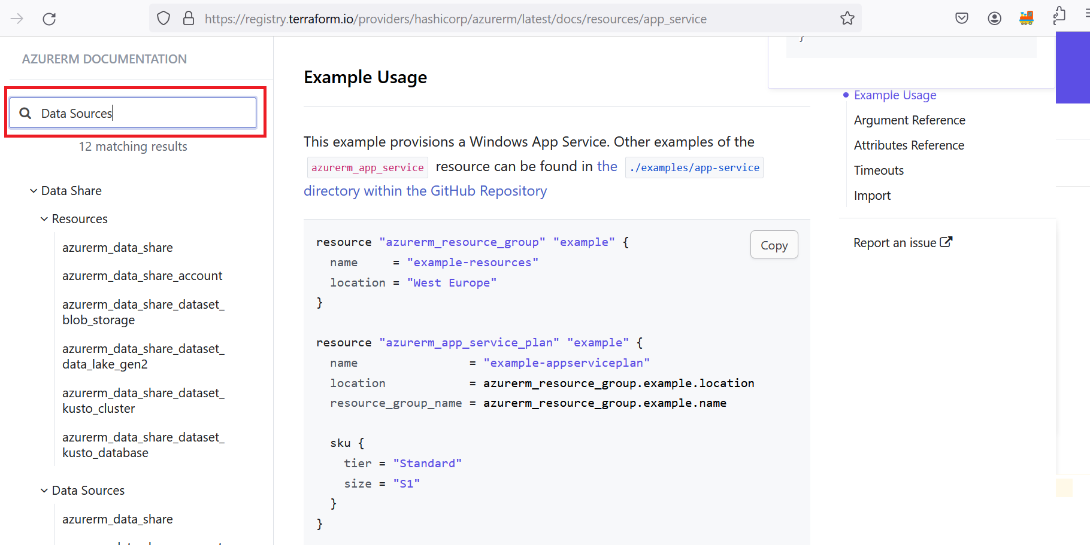

Slide 19
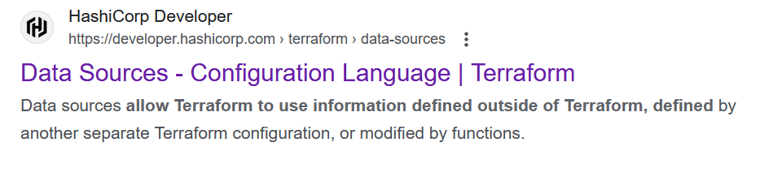
What is Data Sources
Data sources allow Terraform to use information defined outside of Terraform, defined by another separate Terraform configuration, or modified by functions.

Slide 20
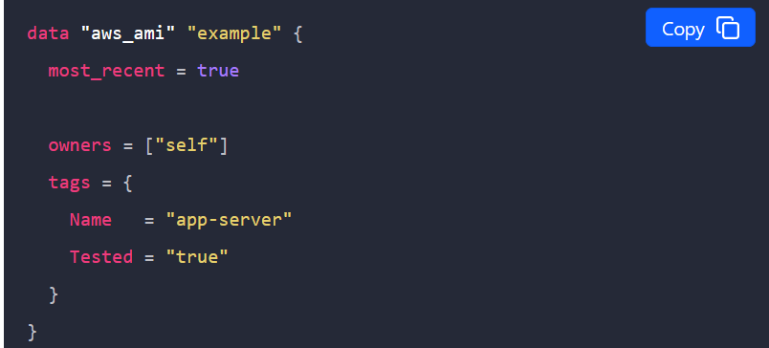
Reading data in terraform configuration
https://developer.hashicorp.com/terraform/language/data-sources

Slide 21
tenant
Tenant: When we are creating account with Azure, we will become tenant[simple term, user]
How to find tenant id?
https://learn.microsoft.com/en-us/entra/fundamentals/how-to-find-tenant

Slide 22
subscription
Azure offers subscription plans for accessing its cloud services, providing flexibility and scalability for businesses.
Agreement for billing.

Slide 23
statefile
Terraform statefile stores information about the managed infrastructure, tracking resource details for synchronization and management purposes.

Slide 24
Terraform Backend
Terraform backend configures where state data is stored, enabling collaboration, versioning, and state management across environments.

Slide 25
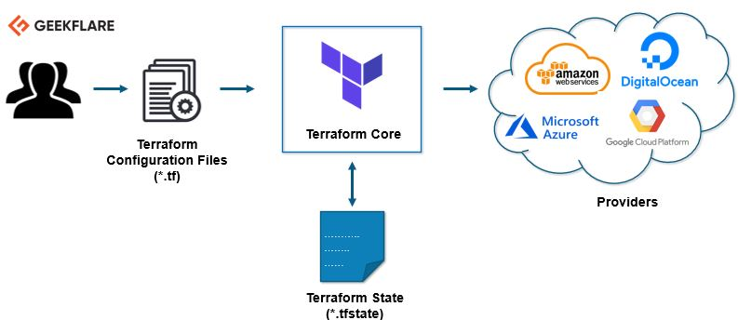
Terraform architecture

Slide 26
Terraform commands
[Link] > https://developer.hashicorp.com/terraform/cli/commands

Slide 27
Module concept
Link: https://developer.hashicorp.com/terraform/language/modules

Slide 28
Terraform workspace
It’s for manging multiple environment with one configuration.
Relatable item: GIT branch
https://developer.hashicorp.com/terraform/language/state/workspaces

Slide 29
Resource replacement
Terraform taint marks a resource as degraded or damaged, indicating that this resource will be destroyed and recreated during the next apply operation. This can be particularly useful when a resource is in an undesirable or unexpected state, but its configuration hasn't changed.
Link: https://spacelift.io/blog/terraform-taint

Slide 30
Null resources in terraform
In Terraform, a null resource is a placeholder that performs actions externally without creating or modifying infrastructure resources.
https://registry.terraform.io/providers/hashicorp/null/latest/docs/resources/resource

Slide 31
Provisioner into terraform
Link: https://developer.hashicorp.com/terraform/language/resources/provisioners/syntax

